Slide 1
AUTOSAR CODE-GENERATION

Slide 2
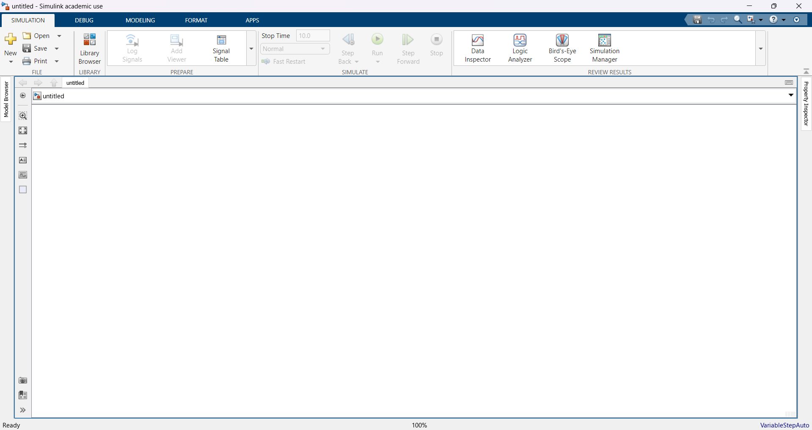
Fig1: Open a New Blank Simulink Model

Slide 3
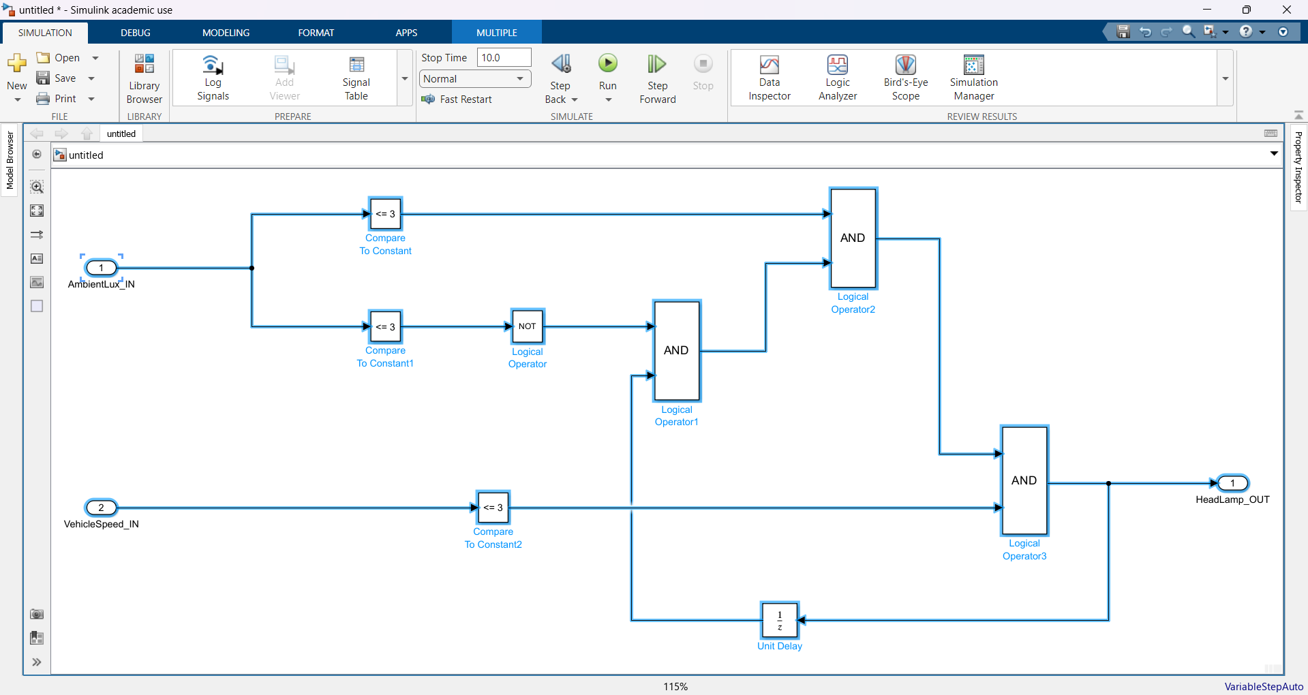
Fig2: Connect with the following blocks as shown in the figure along with the configurations

Slide 4
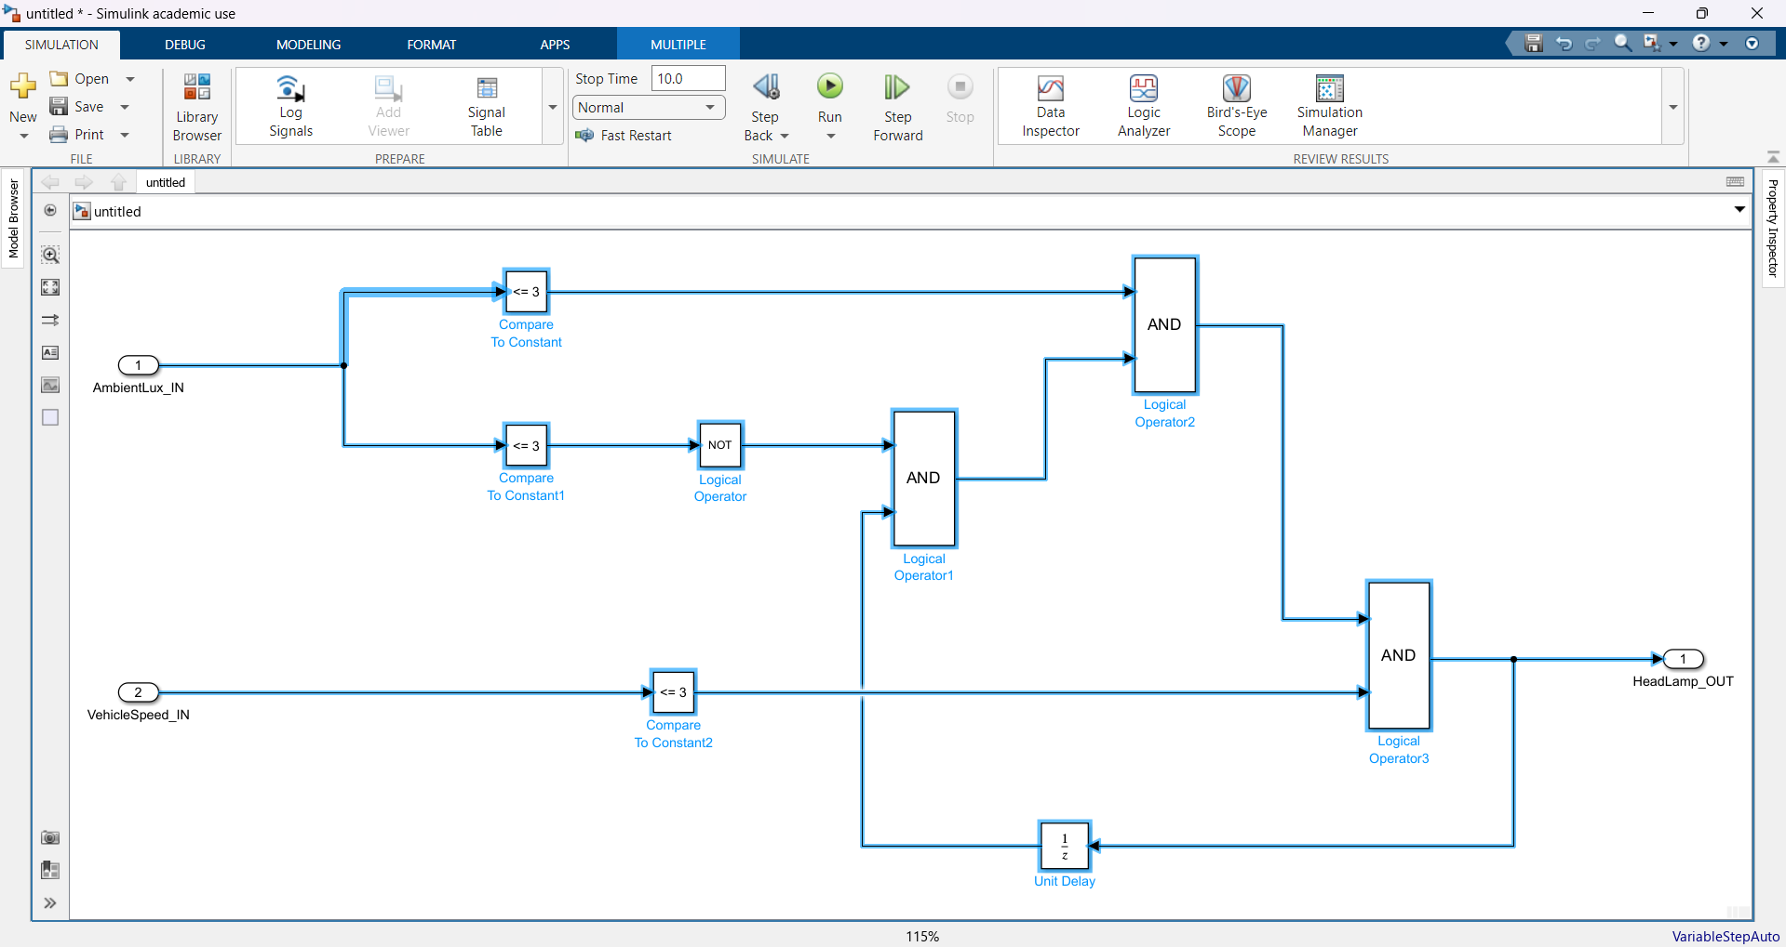
Fig3: Select the following blocks

Slide 5
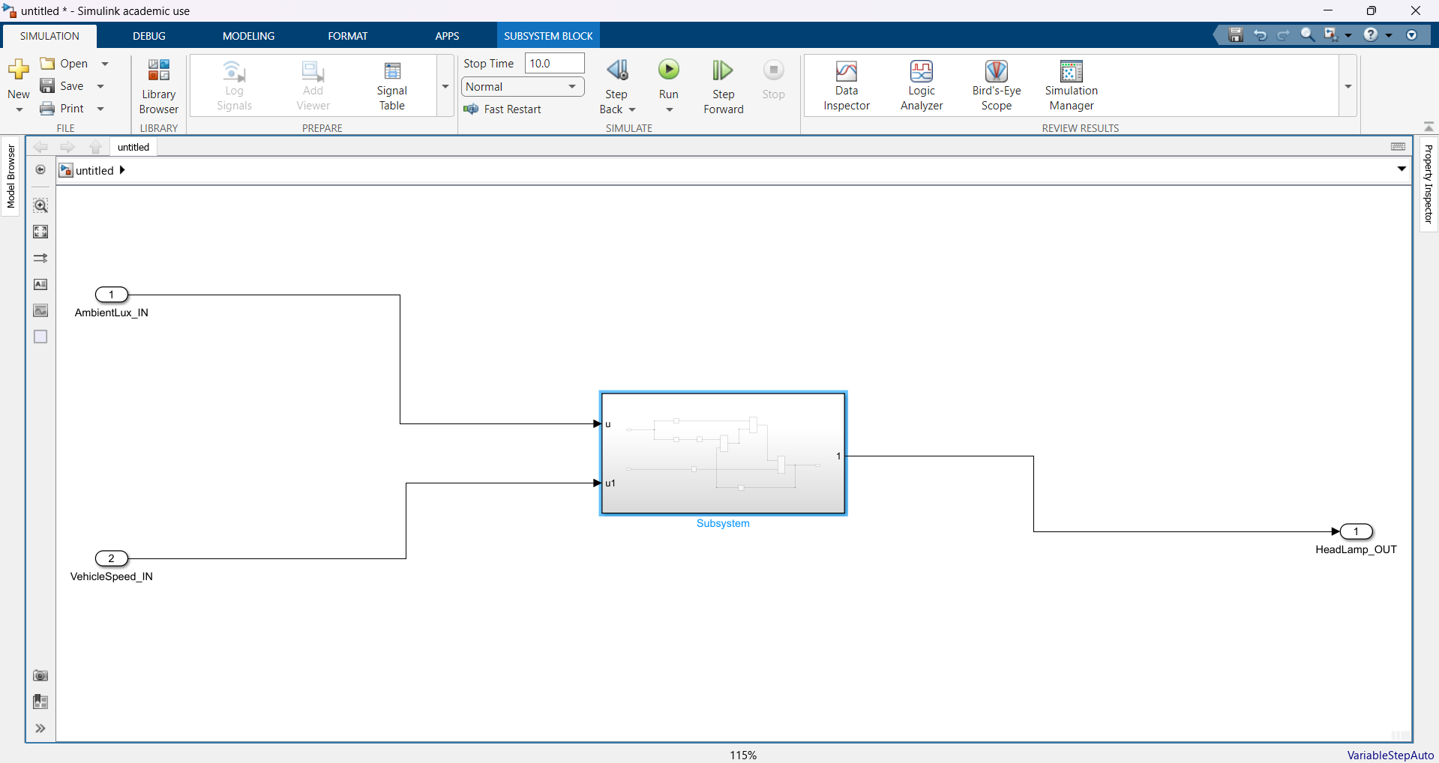
Fig4: Press Ctrl+G (Creates the whole system into a subsystem)

Slide 6
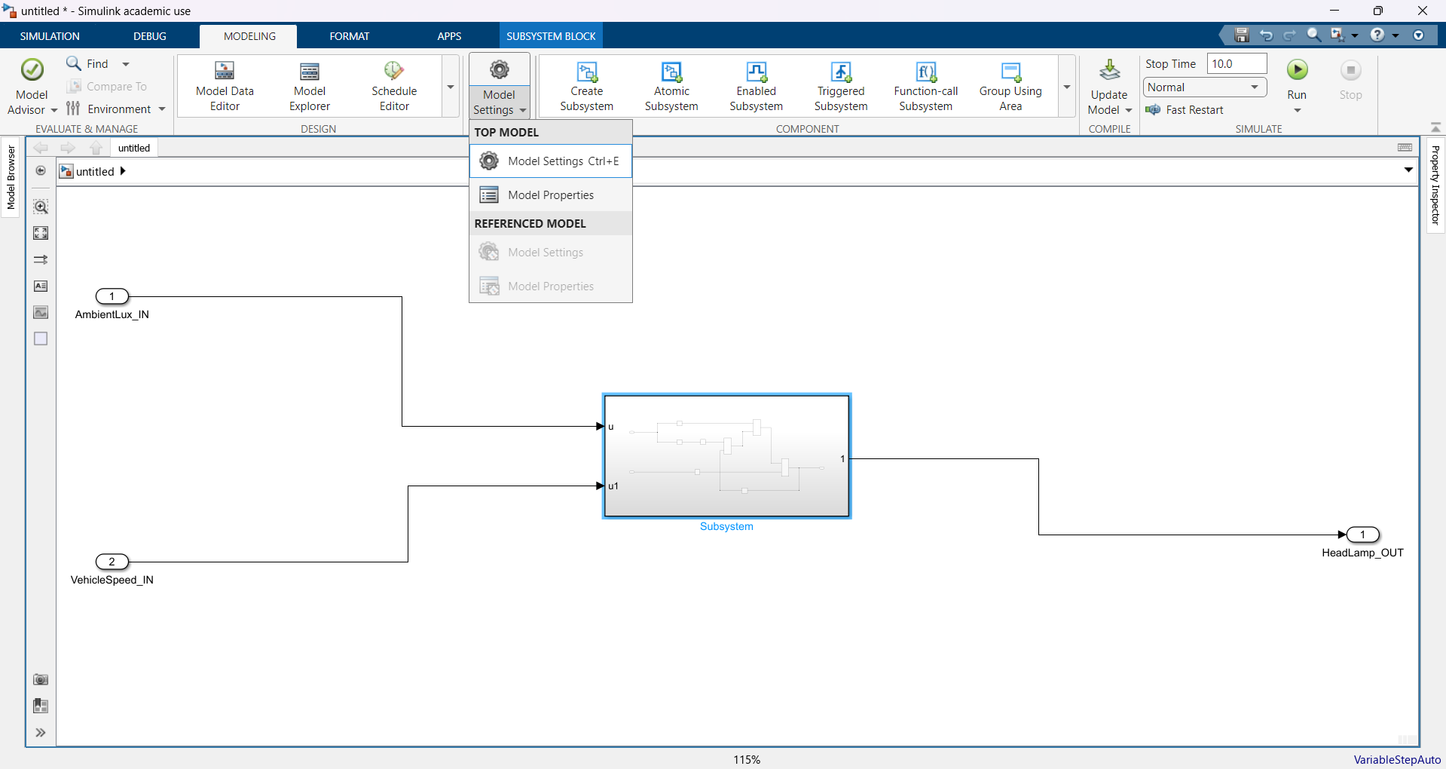
Fig5: Open Model Settings in Modeling Tab

Slide 7
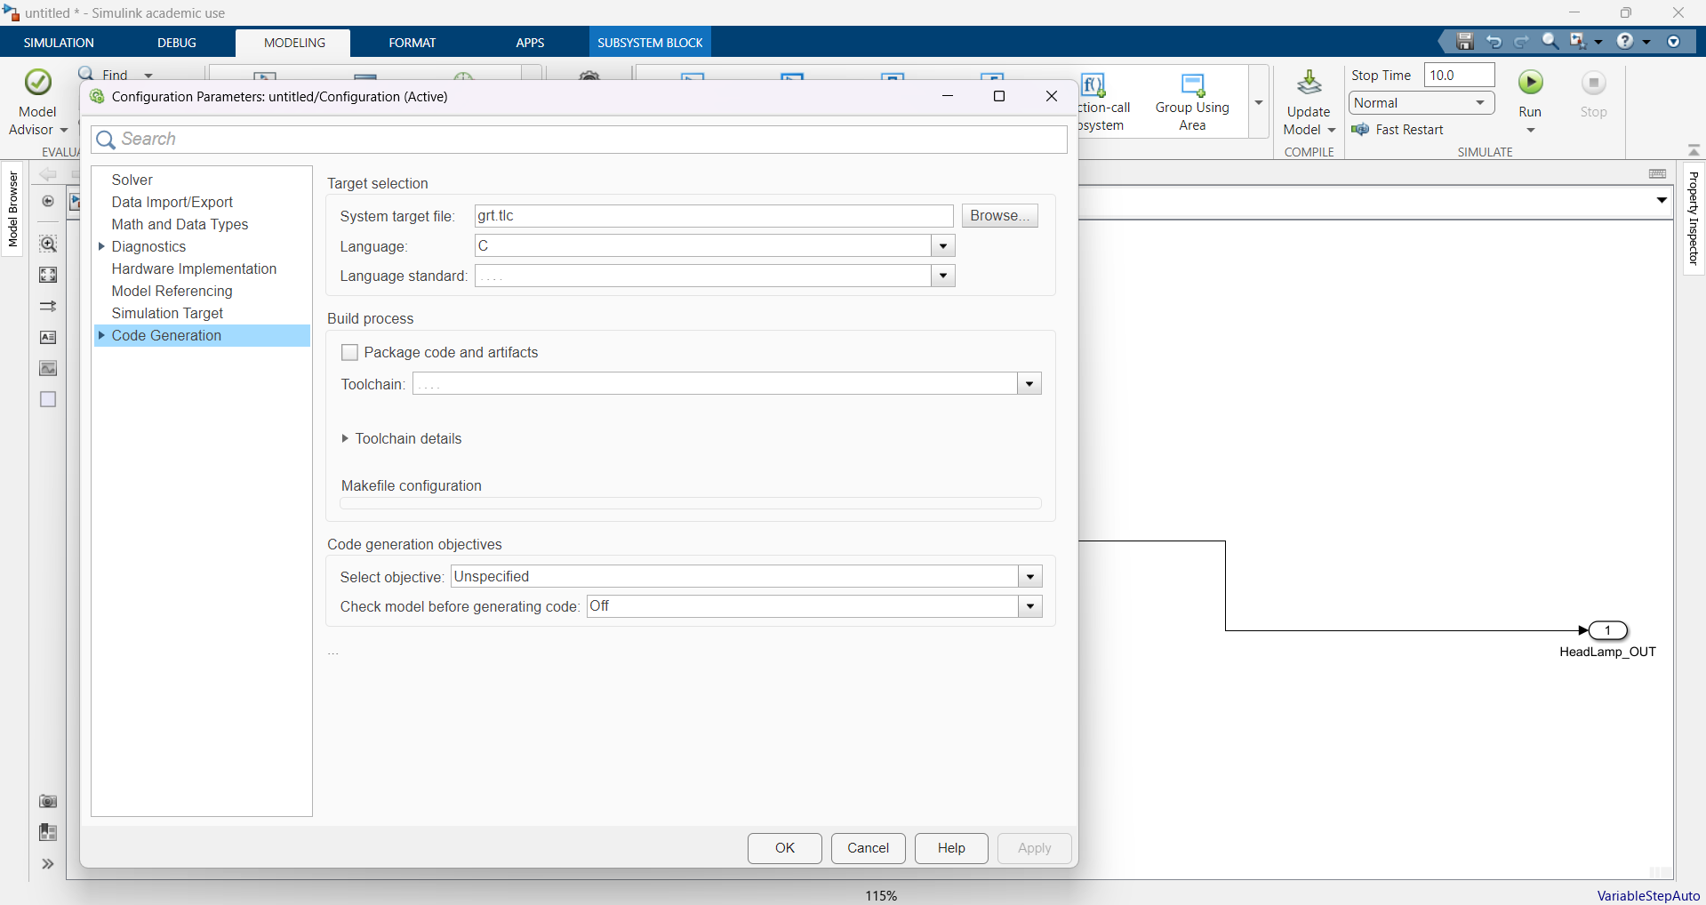
Fig6: Select the Code Generation tab

Slide 8
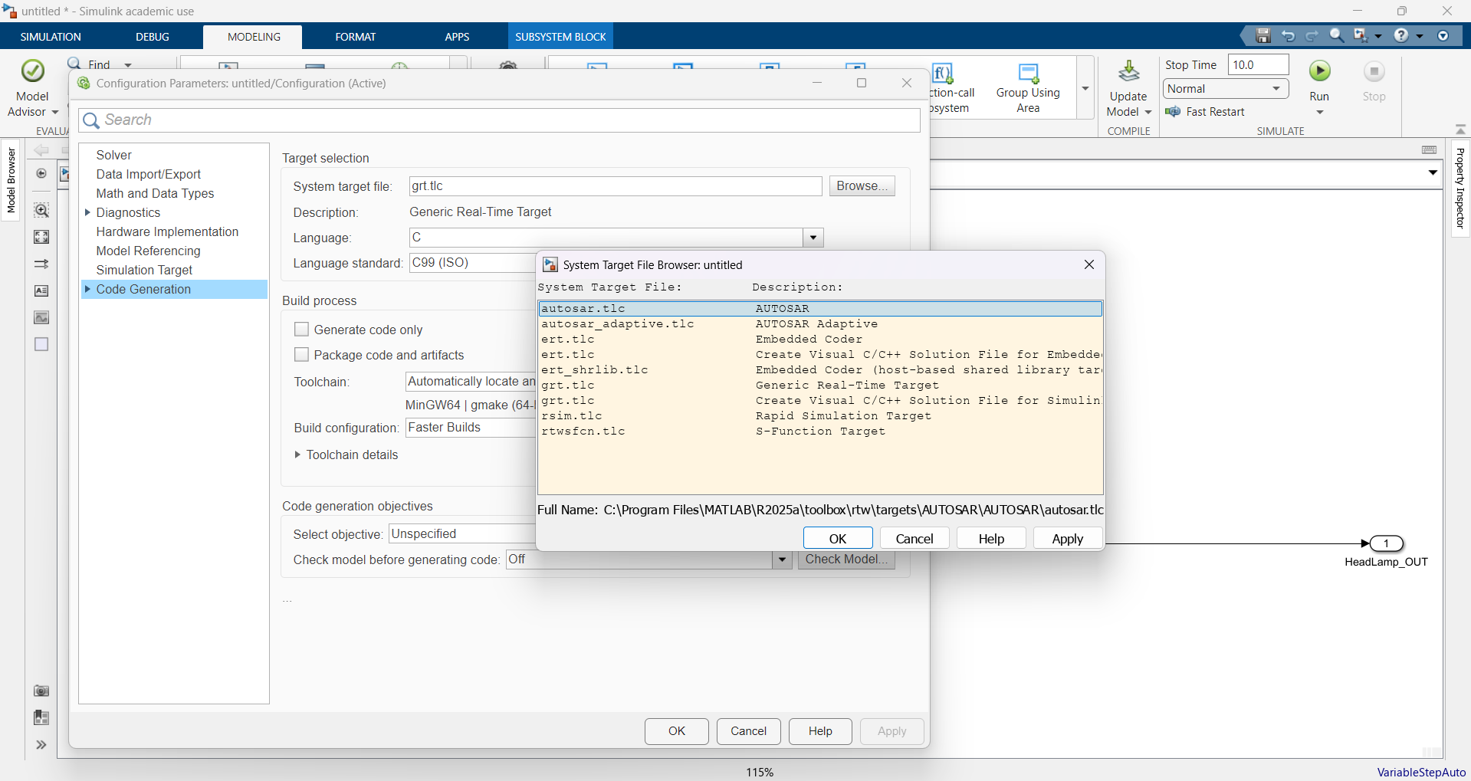
Fig7: Browse the System target file and select autosar.tlc

Slide 9
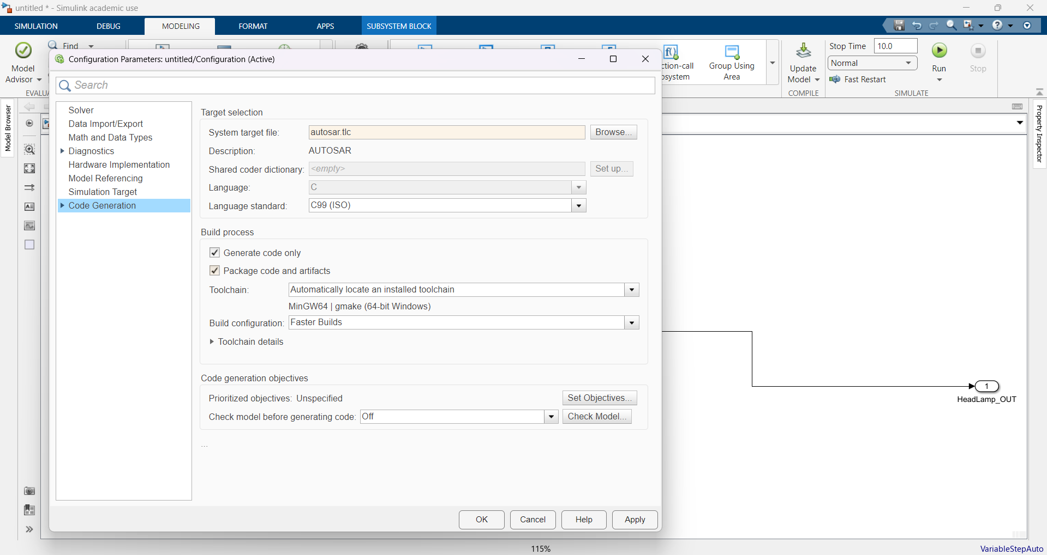
Fig8: Check the Package code and artifacts checkbox

Slide 10
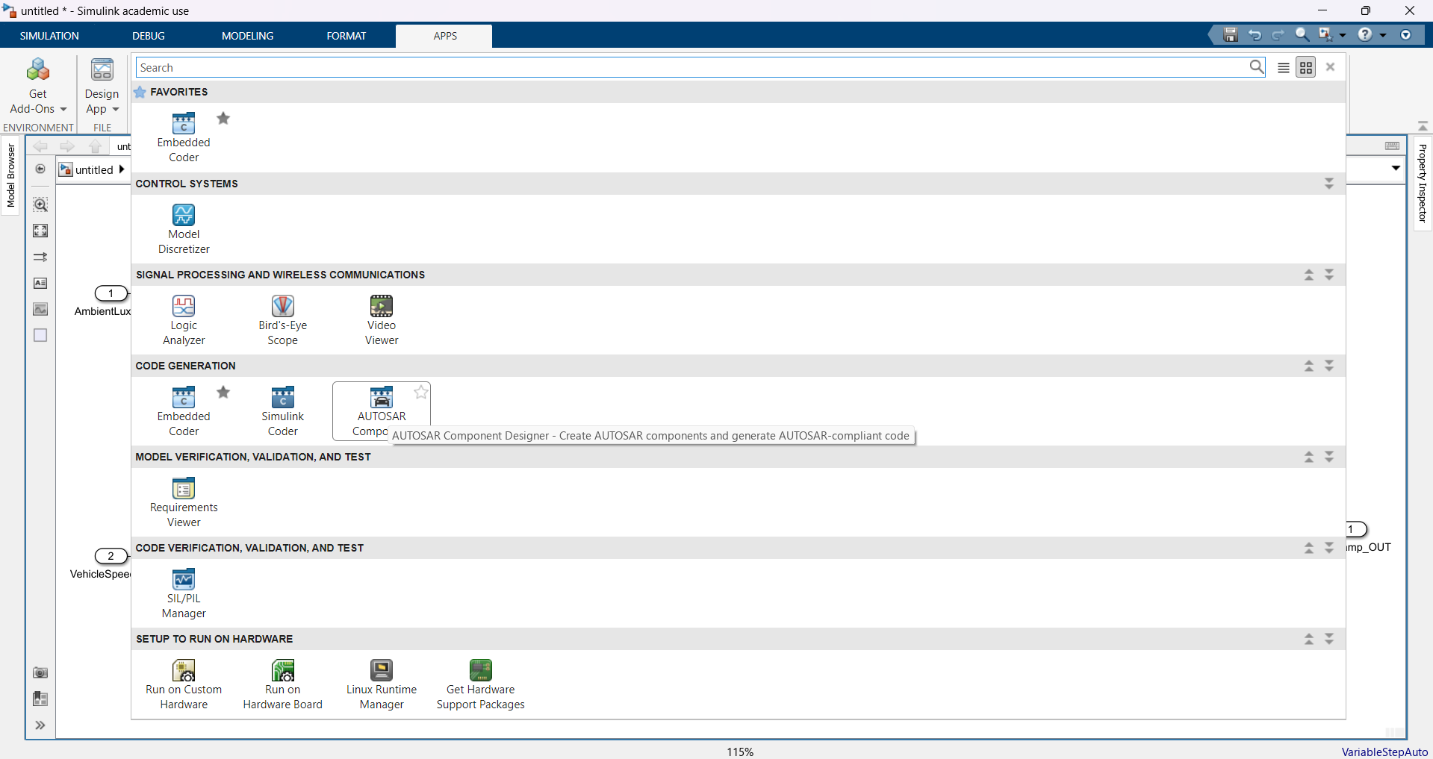
Fig9: Navigate to APPS tab and select AUTOSAR Component Designer

Slide 11
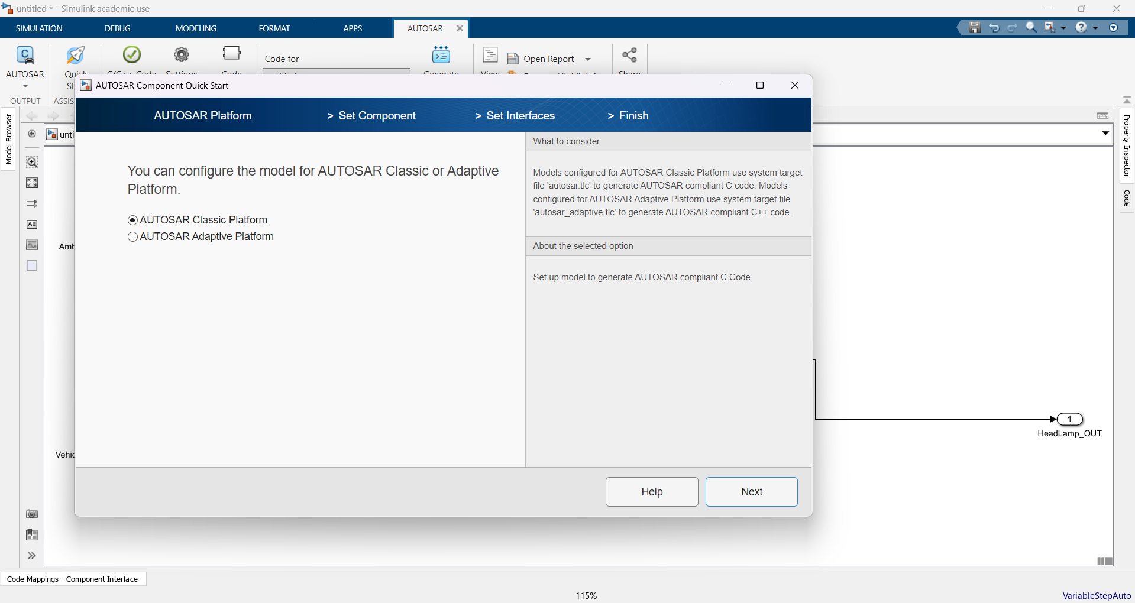
Fig10: Select AUTOSAR Classic Platform and Next

Slide 12
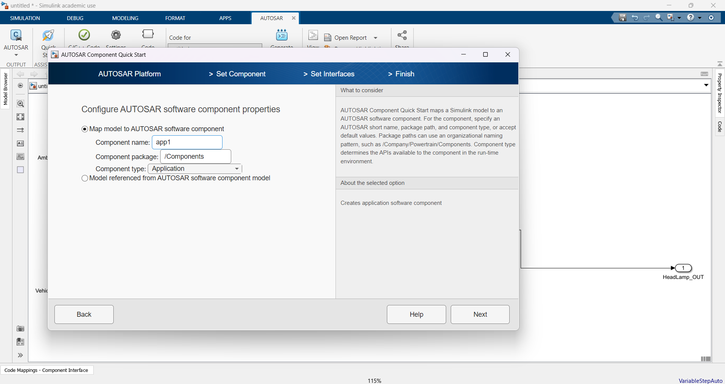
Fig11: Fill the Component name and next

Slide 13

FIg12: Select Create defaults based on the Simulink model and Next

Slide 14
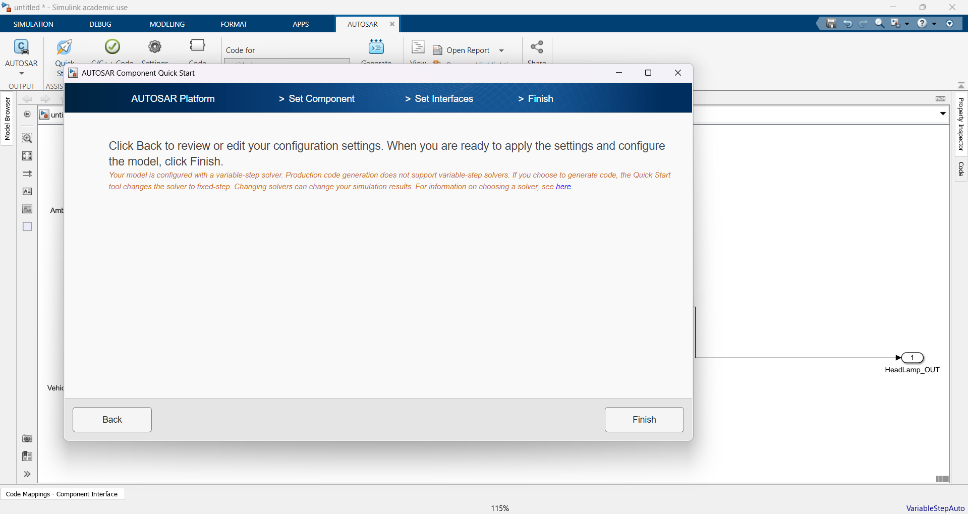
Fig13: Click Finish

Slide 15
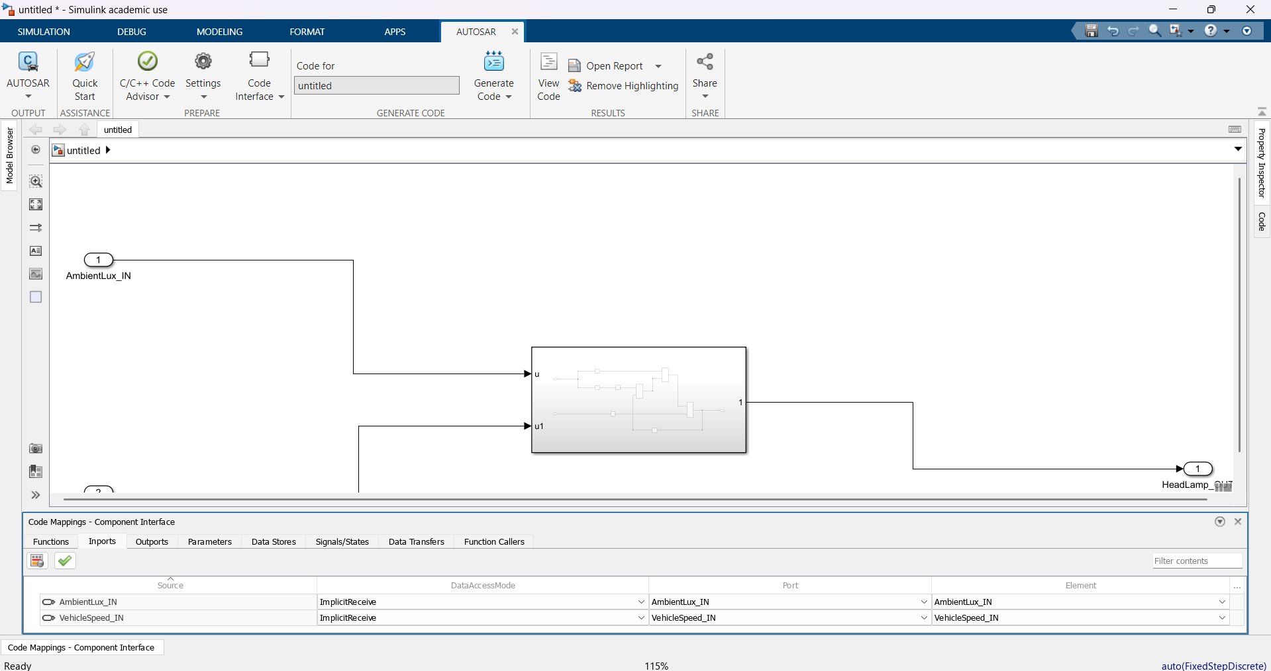
Fig14: Click on Code Mappings – Component Interface to check the inports

Slide 16
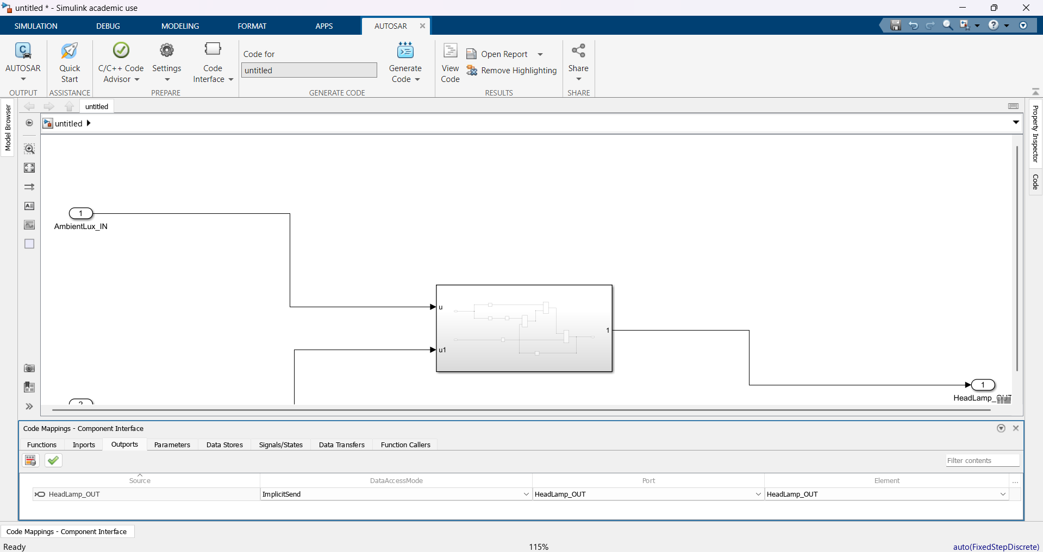
Fig15: Click on Outports to check the outputs

Slide 17
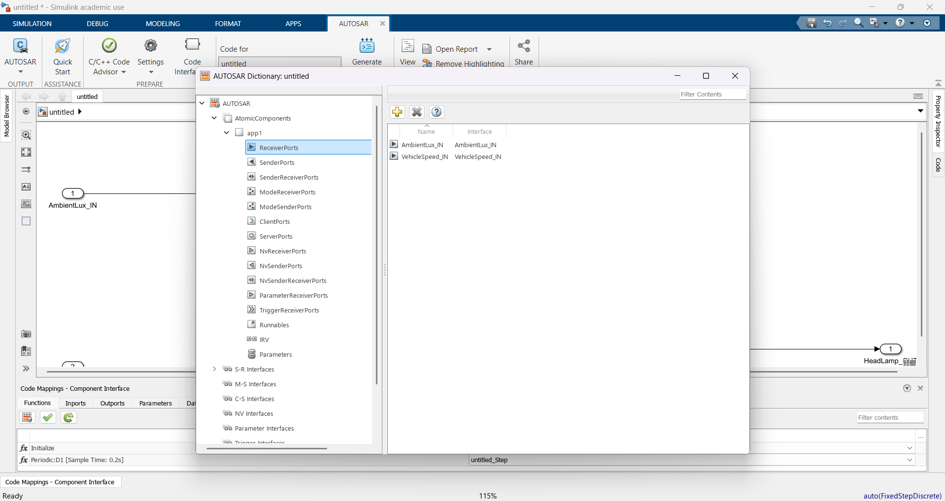
Fig16: Open AUTOSAR Dictionary to check the Reciever Ports

Slide 18
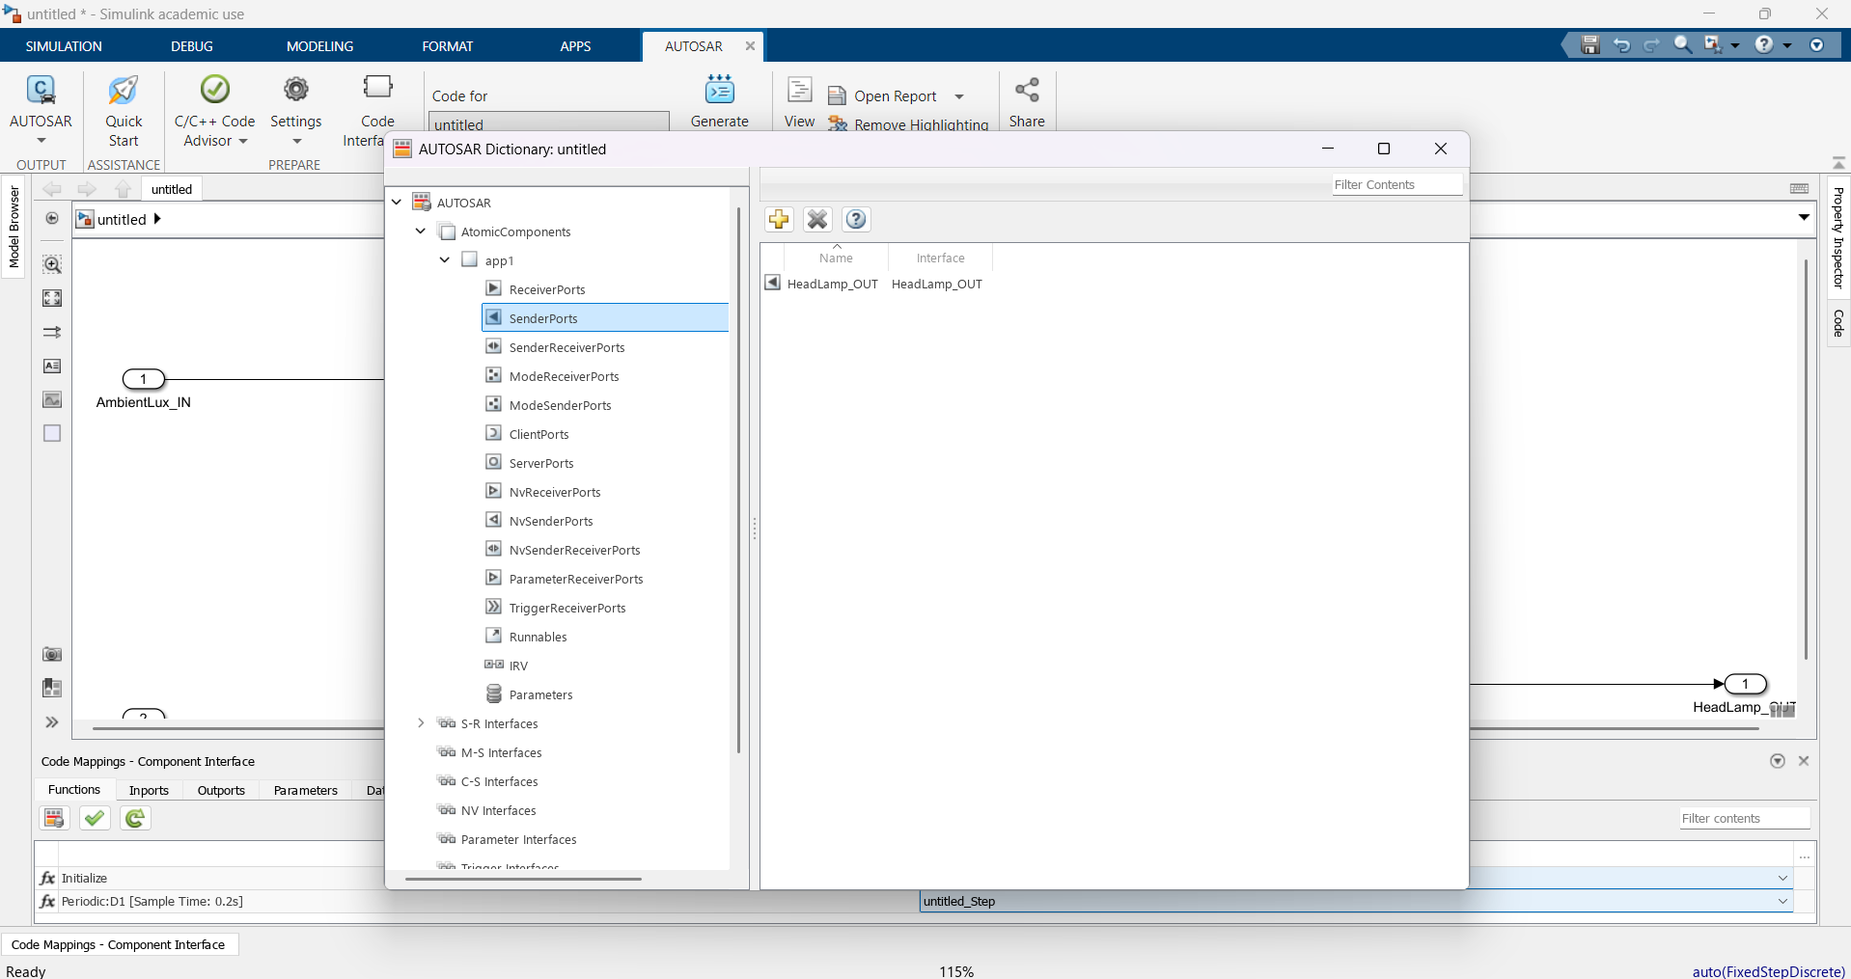
Fig17: Check the Sender Ports

Slide 19
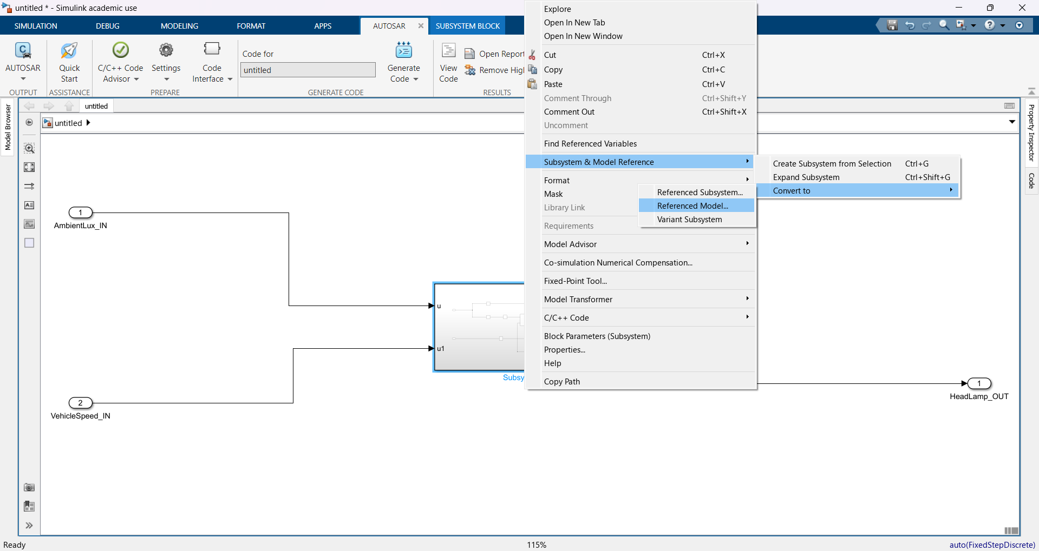
Fig18: Right-Click on the subsystem and navigate to Referenced Model..

Slide 20
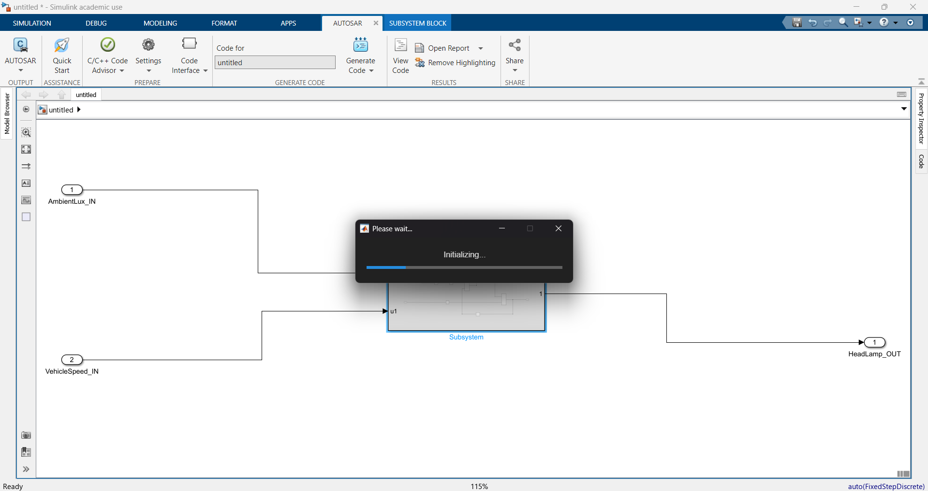
Fig19: Initializing

Slide 21
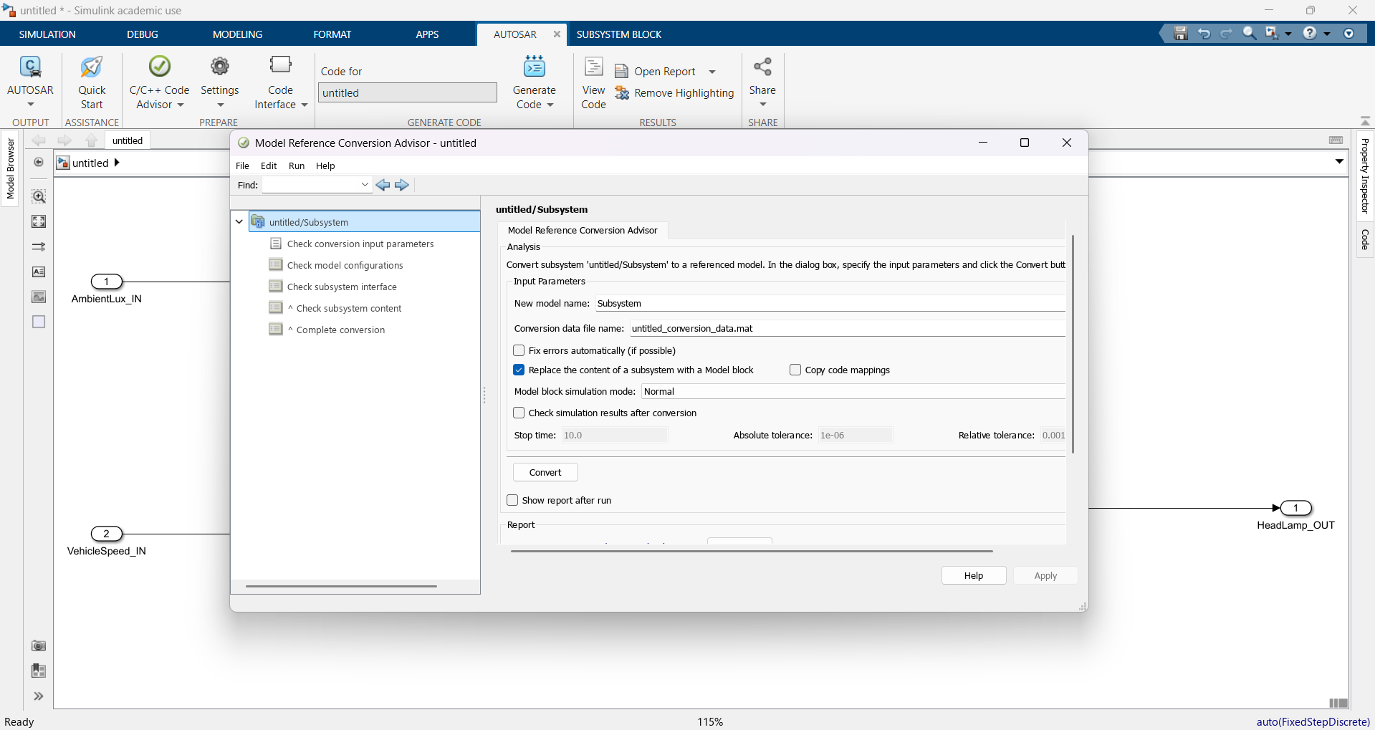
Fig20: Click on Convert

Slide 22
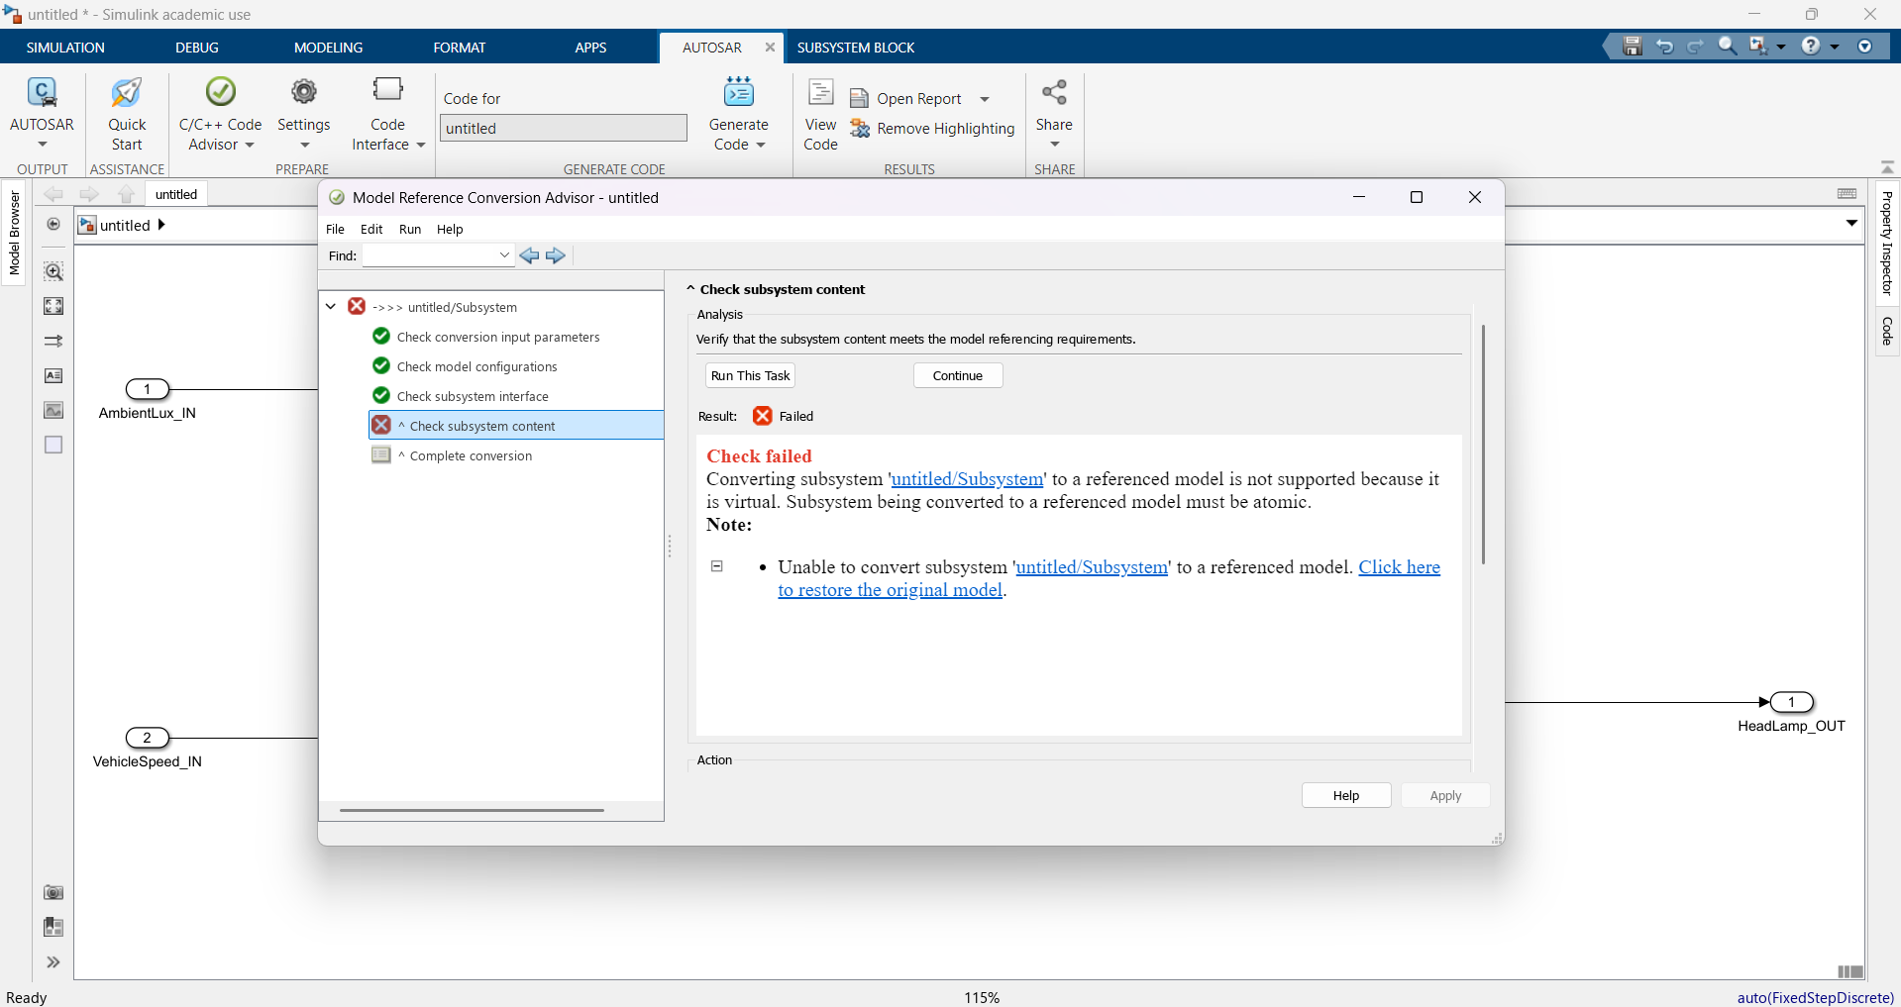
FIg21: Check failed to correct this error….

Slide 23
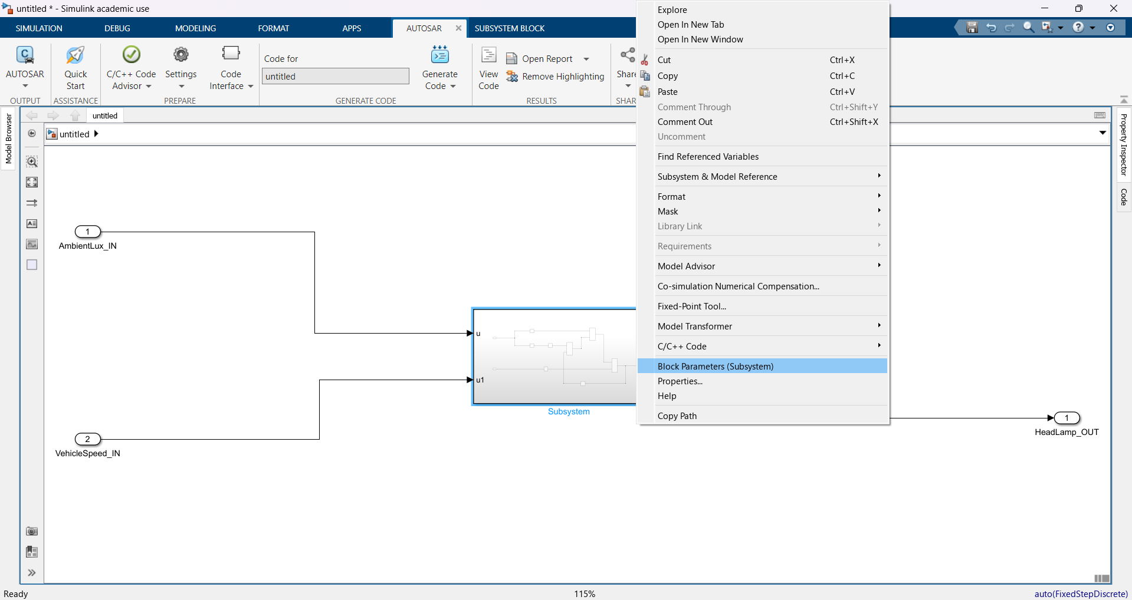
Fig22: Select Block Parameters (Subsystem)

Slide 24
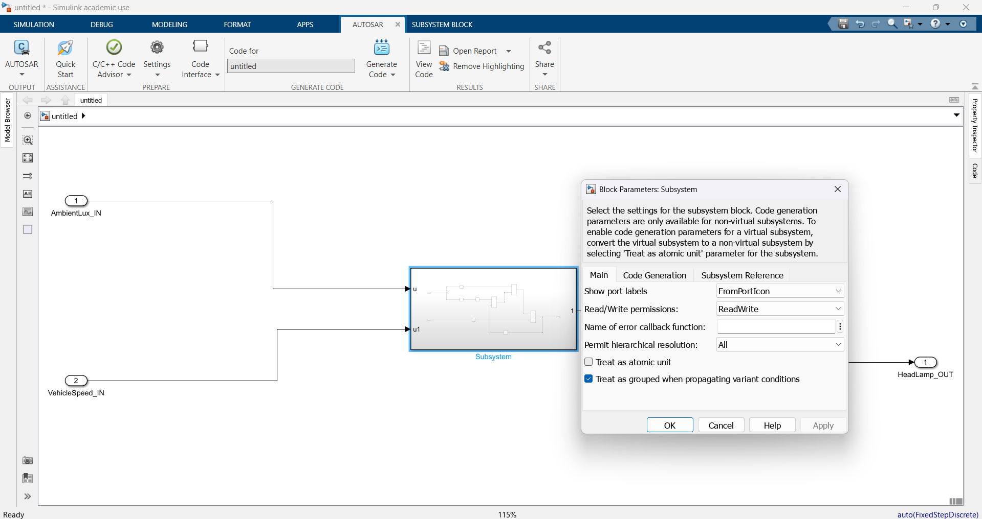
Fig23: A pop-up screen will appear

Slide 25
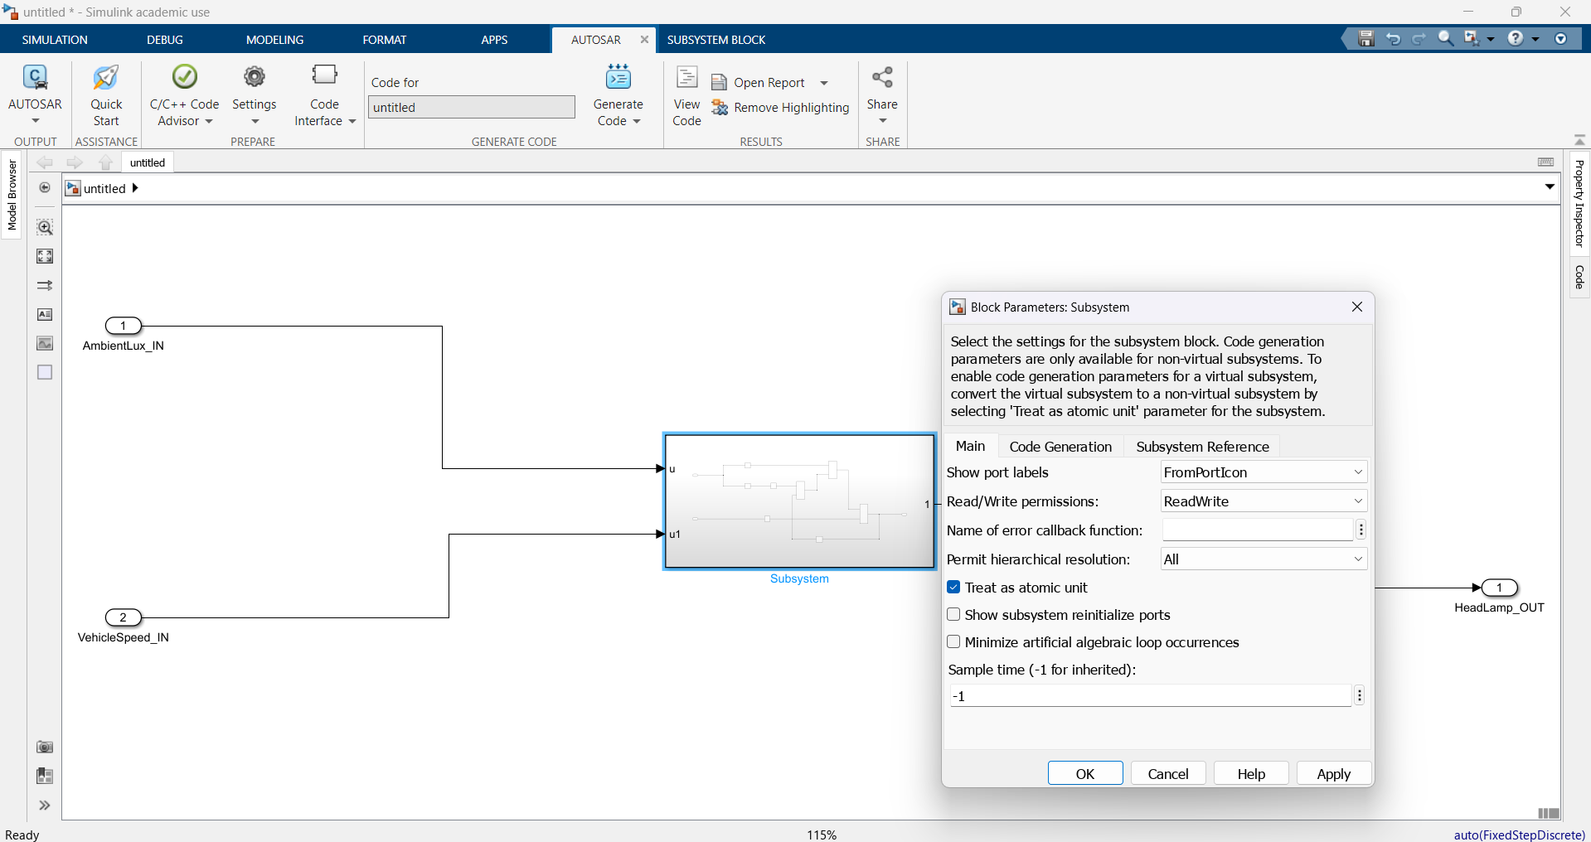
Fig24: Check the Treat as atomic unit checkbox

Slide 26
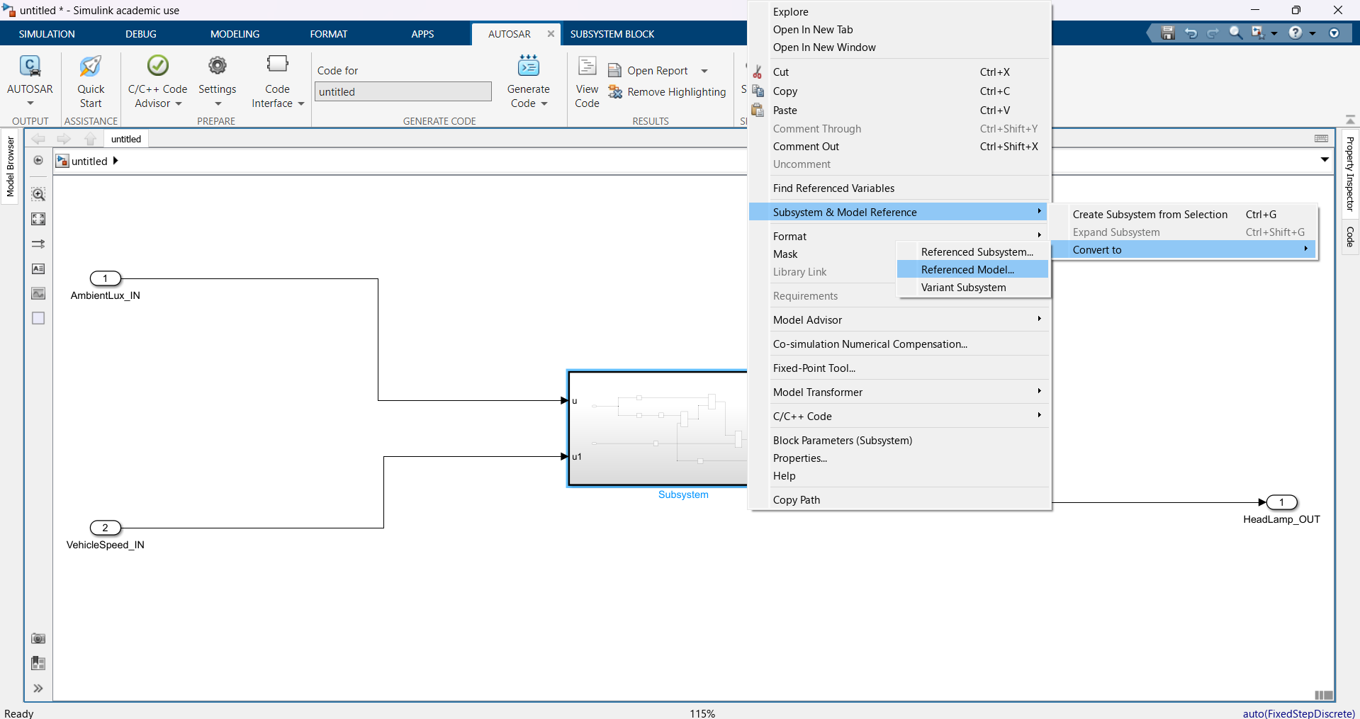
Fig25: Again head to Referenced Model..

Slide 27
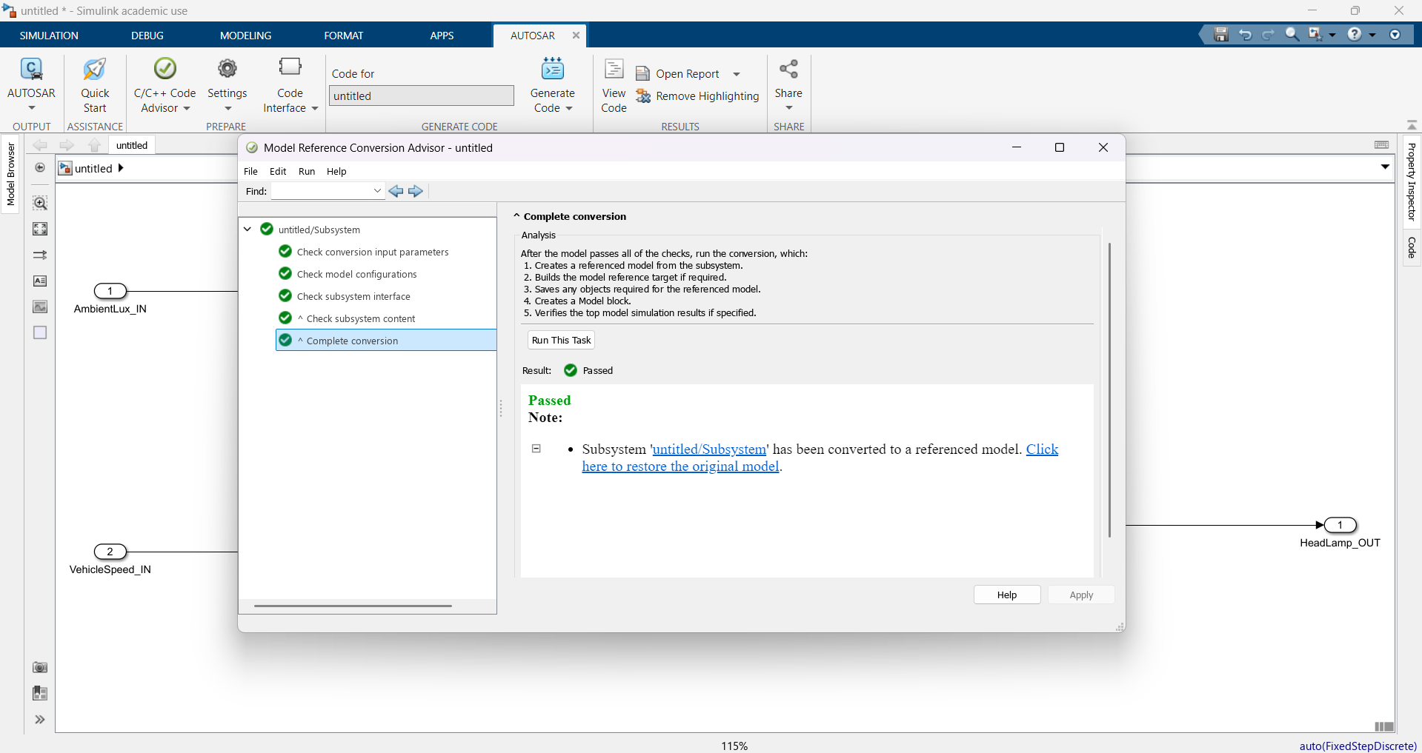
Fig26: Click convert and the system passes the test

Slide 28
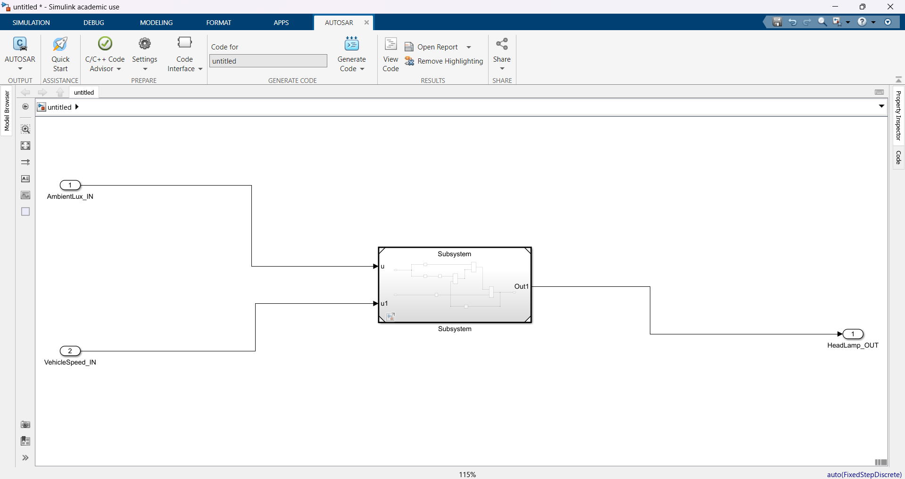
Fig27: Navigate to AUTOSAR tab

Slide 29
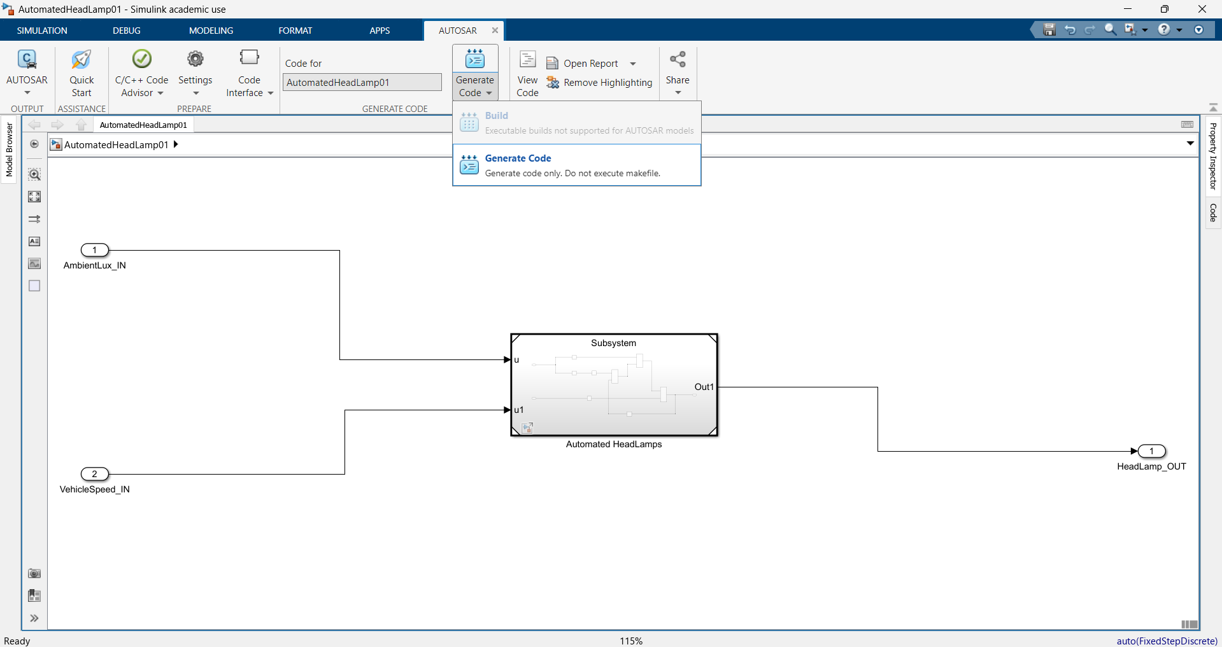
Fig28: Click on Generate Code

Slide 30
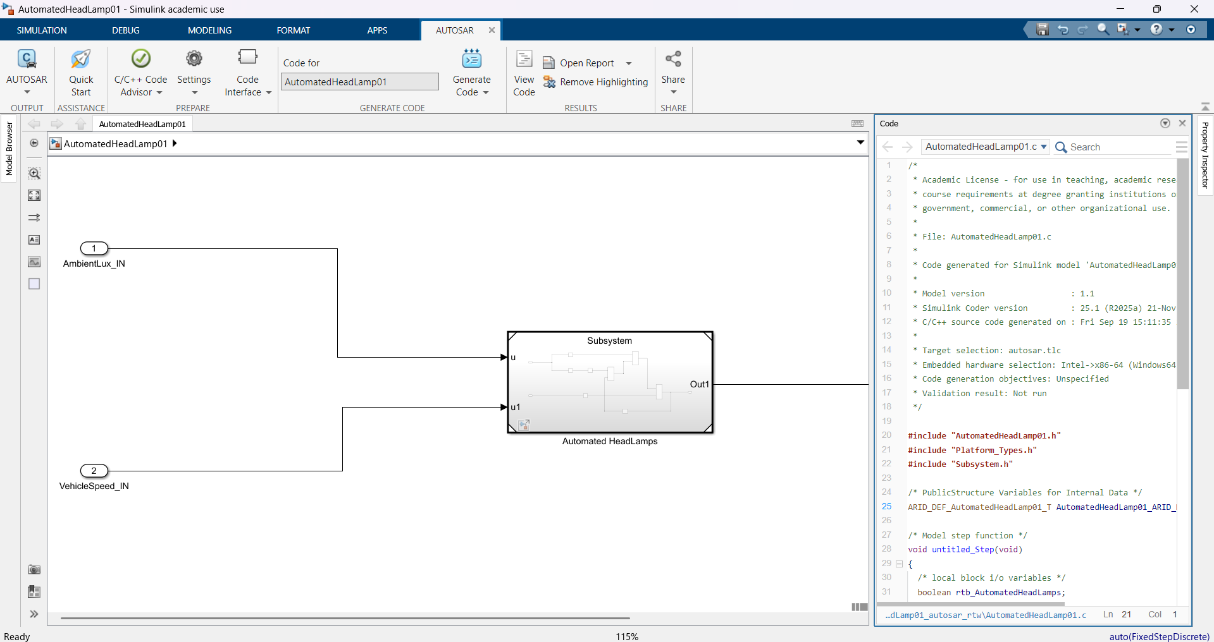
Fig29: The code is displayed on the right side of the screen

Slide 31
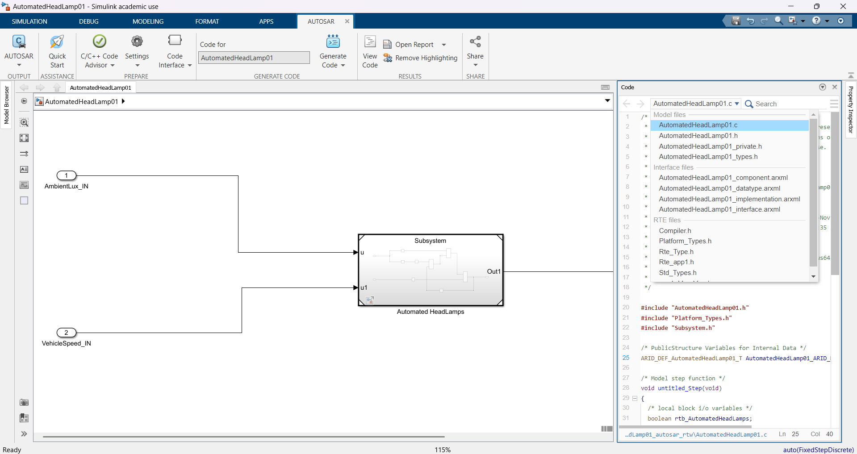
Fig30: The following files are generated

